Slide 1
Chapter 1
Introduction
Data Communication
Networks
Protocols and Standards
Standard Organizations
WCB/McGraw-Hill
© The McGraw-Hill Companies, Inc., 1998

Slide 2
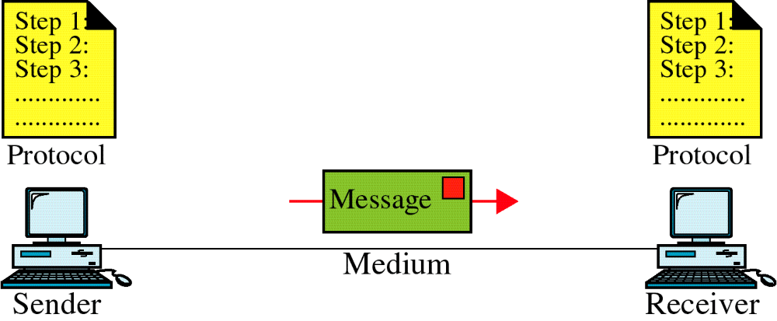
Figure 1-1
Data Communication System Components
WCB/McGraw-Hill
© The McGraw-Hill Companies, Inc., 1998

Slide 3
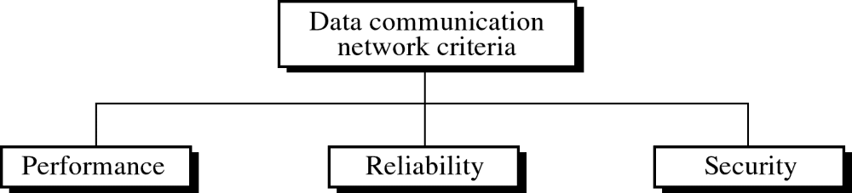
Figure 1-2
WCB/McGraw-Hill
© The McGraw-Hill Companies, Inc., 1998

Slide 4
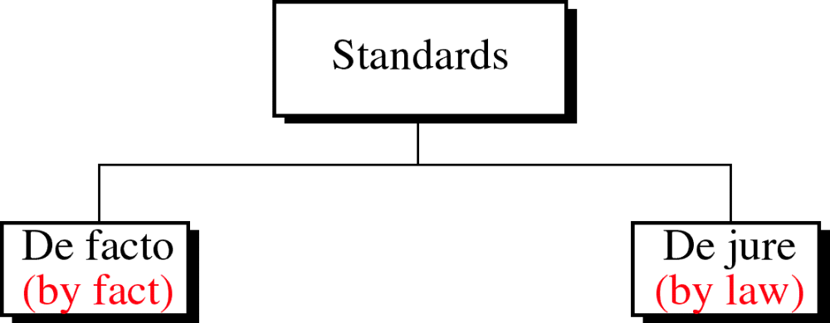
Figure 1-3
WCB/McGraw-Hill
© The McGraw-Hill Companies, Inc., 1998

